Slide 1

Basic Details of the Team and Problem Statement
Ministry/Organization Name/Student Innovation: Ministry of Jal Shakti
PS Code: SIH1289
Problem Statement Title: Projection of the extent of inundation corresponding to the forecasts of flood levels in a river.
Team Name: SKYNET
Team Leader Name: Samarth Pratap Singh
Institute Code (AISHE): 15782701/U0202
Institute Name: Birla Institute of Technology, Mesra
Theme Name: Disaster Management

Slide 2
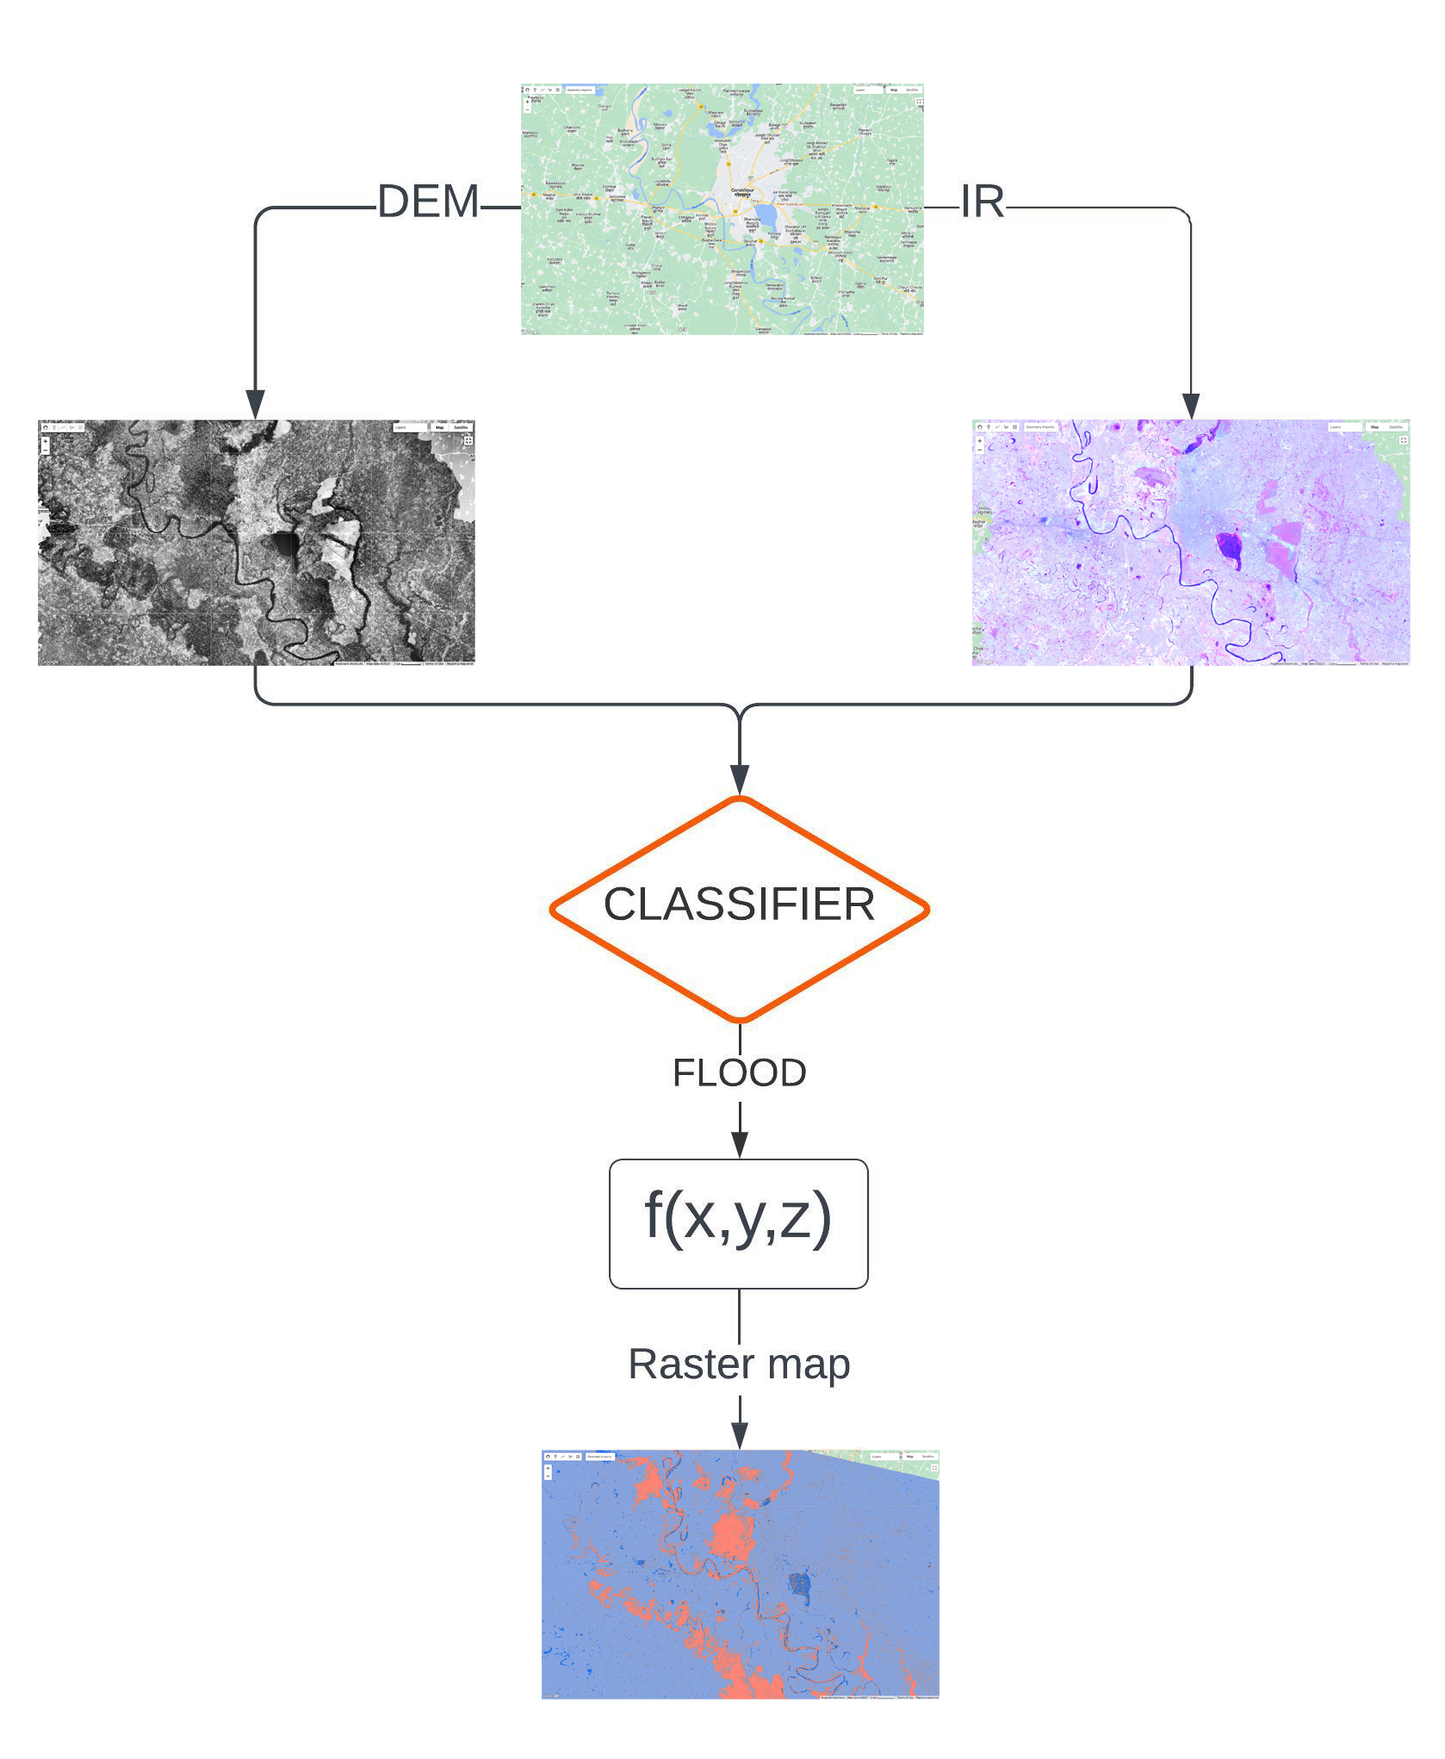
Idea/Approach Details
Idea/Solution/Prototype:
Our model aims to assess the spatial extent of inundation using Machine Learning (ML) and GIS techniques, with a focus on data-driven analysis, modeling and visualization.
The input for our model consists of 3 major parameters which include increase in water level of the river, elevation of the point under consideration wrt river and the distance of the point from the river.
Our model employs a classifier (supervised learning) trained on data from various bands and satellites to categorize the location of interest into two distinct classes: 'Flood' and 'No Flood’.
Then the model utilizes a polynomial regression function that incorporates the mentioned parameters, along with historical data, to dynamically adjust the exponents associated with these parameters. This adjustment process is guided by loss functions, which help fine-tune the model's parameters for improved accuracy.
We utilize this function for the regions marked as ‘Flood’ by our classifier, to generate a value that is subsequently normalized to represent the likelihood of inundation within the region.
The probabilities associated with the regions are then visually represented on a GIS-based application, using a raster map.
SRTM satellite (Shuttle Radar Topography Mission) used for DEM (Digital Elevation Model)
Landsat 8 satellite used for IR (NIR + SWIR + Thermal IR) image
Technology stack:
GIS-based application - Google Earth Engine and Google Earth Pro, QGIS.
Languages and frameworks - JavaScript, python, pandas, NumPy, Scikit-learn, TensorFlow.
Satellite Imagery provided by - SRTM, Copernicus, Landsat, Sentinel.
VCS - Git, GitHub.

Slide 3
Idea/Approach Details
Dependencies / Show stoppers:
Use Cases:
Data Availability and Quality: Incomplete, outdated, or noisy data can lead to inaccurate predictions.
Spatial and Temporal Resolution: The spatial and temporal resolution of satellite imagery may not be sufficient for certain localized or rapidly changing flood events.
Cloud Cover and Atmospheric Conditions: Cloud cover and atmospheric conditions can obstruct the view of the Earth's surface, making it challenging to obtain clear and continuous data.
Data Processing Complexity: Processing and analyzing large volumes of remote sensing data, can be computationally intensive.
Model Generalization: Ensuring that the model is capable of generalizing to different geographic regions.
Disaster Management and Response- Providing real-time information on flooded areas, helping emergency services plan rescue and relief operations efficiently.
Flood Forecasting and Early Warning Systems- Predicting the likelihood and severity of floods in real-time to provide early warnings to relevant authorities and communities.
Urban Planning and Infrastructure Development- Identify areas at risk of floods and plan infrastructure and land use accordingly.
Infrastructure Monitoring- Implement an early warning system to detect potential threats in infrastructures such as dams and bridges.
Ecosystem Conservation- Monitor water levels in critical ecosystems using satellite data to ensure that water levels remain within the required range to support biodiversity and maintain ecological balance.
Agriculture and Crop Management- Optimize irrigation scheduling based on water levels in nearby rivers or reservoirs. Help farmers make data-driven decisions to conserve water resources.
Future scope:
Increase the input parameters.
Replacing regression by a CNN (Convolutional Neural Network).
Improvement in the classifier to extend classes to ‘High flood’, ‘Mid flood’ and ‘Low flood’.
Analysis of concealed features in the exported GEOTIFF files.

Slide 4
Team Member Details
Team Leader Name: Samarth Pratap Singh
Branch (Btech/Mtech/PhD etc): Btech Stream (ECE, CSE etc): IT Year (I,II,III,IV): III
Team Member 1 Name: Amogh Huddar
Branch (Btech/Mtech/PhD etc): Btech Stream (ECE, CSE etc): IT Year (I,II,III,IV): III
Team Member 2 Name: Kshitij Jha
Branch (Btech/Mtech/PhD etc): Btech Stream (ECE, CSE etc): ECE Year (I,II,III,IV): III
Team Member 3 Name: Vikram Verma
Branch (Btech/Mtech/PhD etc): Btech Stream (ECE, CSE etc): ECE Year (I,II,III,IV): III
Team Member 4 Name: Bhakti Shirsat
Branch (Btech/Mtech/PhD etc): BArch Stream (ECE, CSE etc): Architecture Year (I,II,III,IV): III
Team Member 5 Name: Priyanshu Kumar
Branch (Btech/Mtech/PhD etc): Btech Stream (ECE, CSE etc): Mechanical Year (I,II,III,IV): III

